Slide 1


DIABETES PREDICTION
ANALYSIS
PRESENTED BY : SAGAR PUNDIR

Slide 2
OBJECTIVE
The Objective of this project is to analyze the dataset containing various demographic and
historic data related to patients health attributes such as patient id, ages, BMI , blood glucose
level etc. Through the comprehensive data analysis by leveraging the SQL queries and
techniques such as data integration and statistical analysis to find the patterns and relationships
between the patient attributes and likelihood of diabetes.
The ultimate goal of this project is to generate and provide valuable insights by using the SQL
queries in the dataset , so thereby contributing to improve healthcare outcomes and the quality
of life for individuals at risk of diabetes.

Slide 3
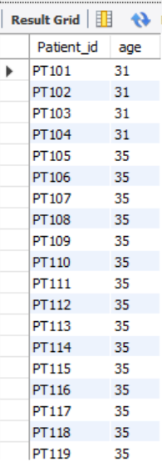

1- Retrieve the Patient id and ages of all Patients.

Slide 4
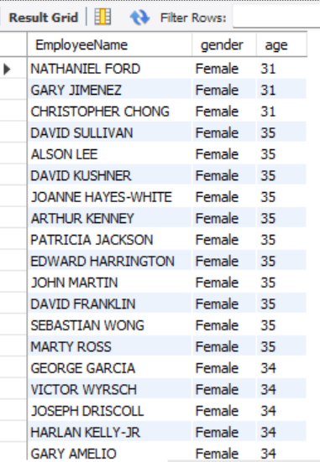
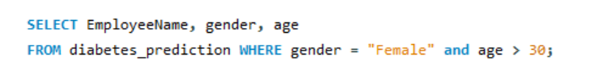
2- Select all Female Patients who are older than 30.

Slide 5
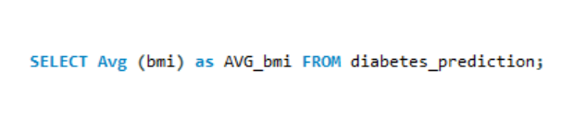
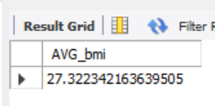
3- Calculate the average BMI of patients.

Slide 6
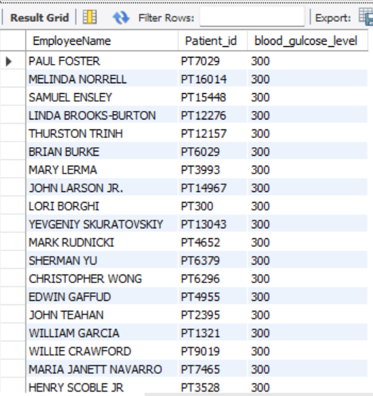
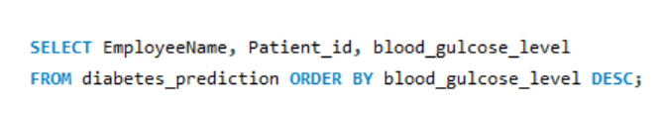
4- List patients in descending order of blood glucose levels.

Slide 7
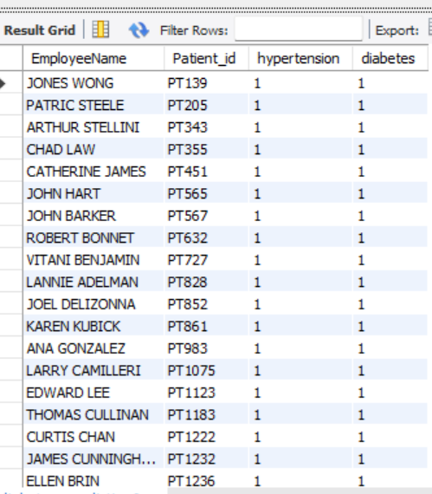

5- Find patients who have hypertension and diabetes.

Slide 8
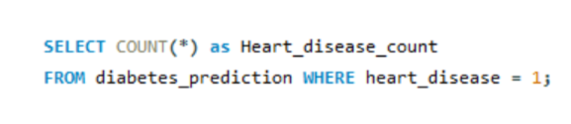
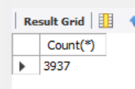
6- Determine the number of patients with heart disease.

Slide 9
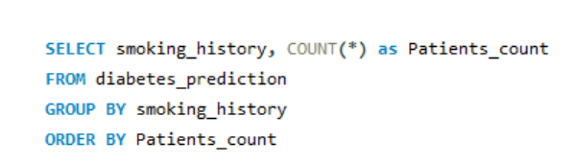
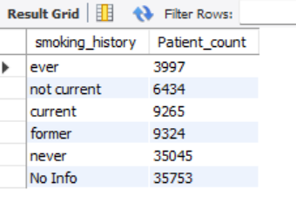
7- Group patients by smoking history and count how many smokers
and non-smokers there are.

Slide 10
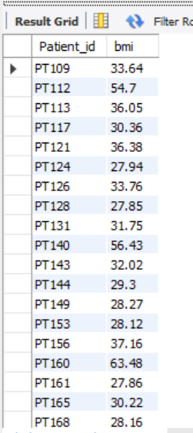
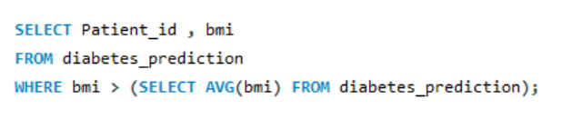
8- Retrieve the Patient id of patients who have a BMI greater than
the average BMI.

Slide 11
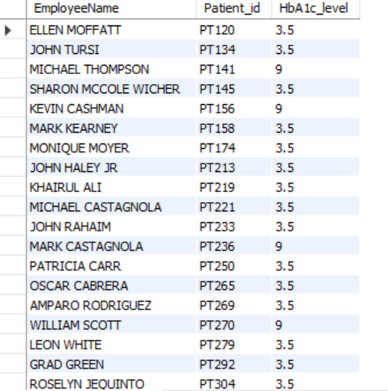
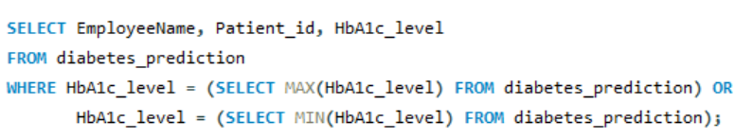
9- Find the patient with the highest HbA1c level and the patient
with the lowest HbA1c level.

Slide 12
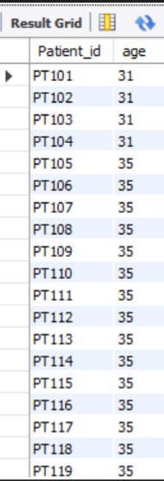
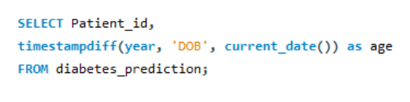
10- Calculate the age of patients in years
(assuming the current date as of now).

Slide 13
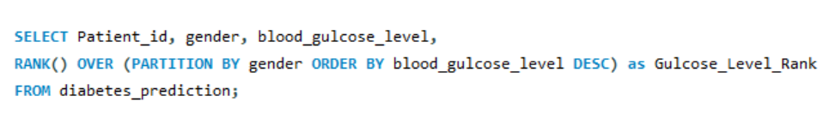
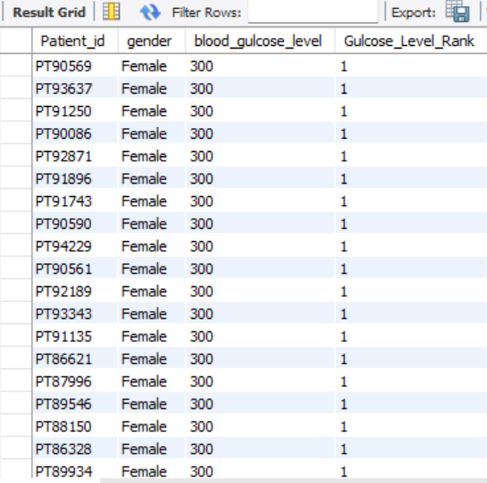
11- Rank patients by blood glucose level with each gender group.

Slide 14
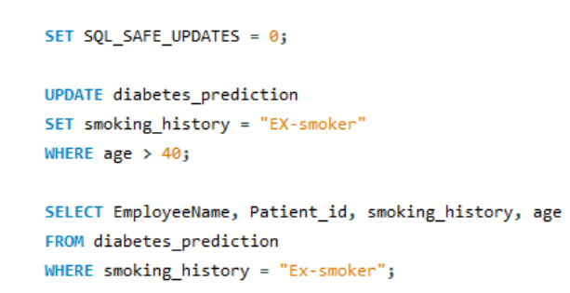
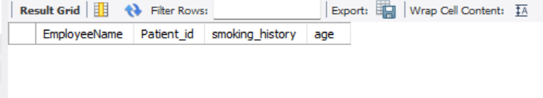
12- Update the smoking history of patients who are older than 40
to “Ex-smoker”.
There is no smoking history of patients who are older than 40 to “Ex-smoker”

Slide 15
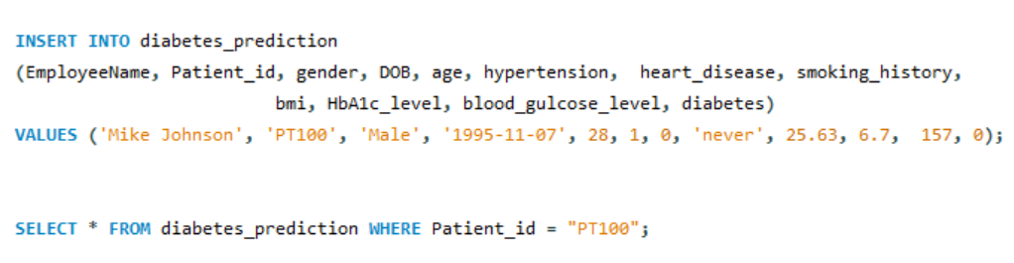
13- Insert a new patient into the database with sample data.

Slide 16
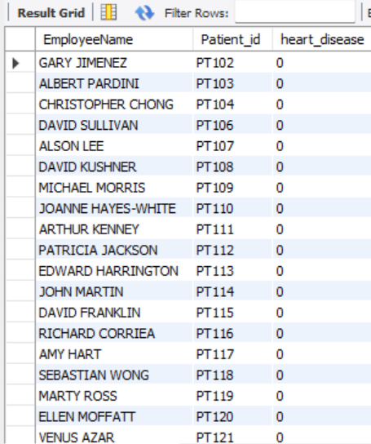
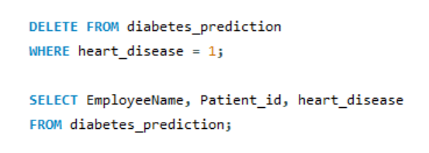
14- Delete all patients with heart disease from the database.

Slide 17
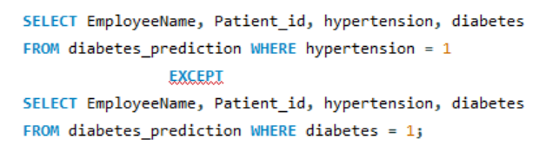
15- Find patients who have hypertension but not diabetes using
the EXCEPT operator.

Slide 18
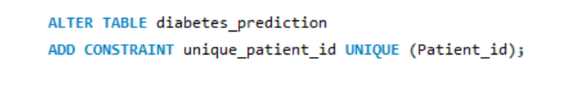
16- Define a unique constraint on the “Patient id” column to entire
its values are unique.

Slide 19
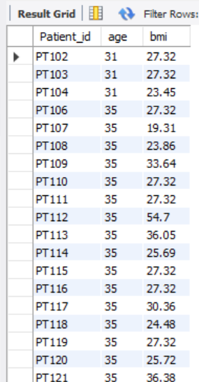
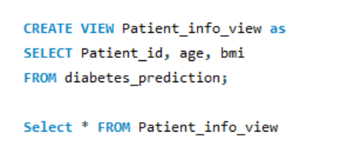
17- Create a view that displays the Patient ids, ages, and BMI of patients.

Slide 20
18- Suggest improvements in the database scheme to reduce data
redundancy and improve data integrity.
1- Applying the master data
2- Normalizing databases
3- Entity Relationship Diagram(ERD)
4- Remove unused data
5- Indexing
6- Regular maintenance
7- Data Types and Constraints
8- Attribute Separation
9- Removing Denormalization
10- Data Validation and Cleaning

Slide 21
19- Explain how can you optimize the performance of SQL queries on
this dataset.
1- Indexing: Identify the columns frequently used in WHERE clauses or join the conditions so
that this speeds up data retrieval by enabling the database.
2- Normalization: Ensure that the database schema is properly normalized to minimize data
redundancy and improve query efficiency.
3- Query Optimization: Write the efficient SQL queries by avoiding the unnecessary columns
and using the appropriate SQL commands so that we get the limited number of rows returned.
4- Hardware Optimization: Ensure that the database server is properly configured with sufficient
memory ,CPU resources to handle query loads efficiently.
5- Database Maintenance: Regularly perform database maintenance tasks such as vacuuming,
reindexing, and updating statistics to ensure optimal performance and prevent performance
degradation over time.

Slide 22
CONCLUSION
By analysing the dataset using the SQL queries we get the necessary information
on the demographics of patients and their health outcomes.
The maximum blood glucose level was 300 and heart disease for about 3937 persons.
The patients having highest HbA1c level is 9 and the lowest HbA1c level is 3.5.
The Person who have diabetes with smoking habit is around 9265.
The number of patients with heart disease is mainly due to their smoking habit.
We can suggest that we can take care of our health by avoiding the smoking habit
and live longer.
SOL- based Diabetes prediction analysis offers a powerful framework for leveraging
data-driven insights to support personalized healthcare interventions, improve patient
outcomes and to contribute the population health management.

Slide 23
THANK YOU

